Slide 1
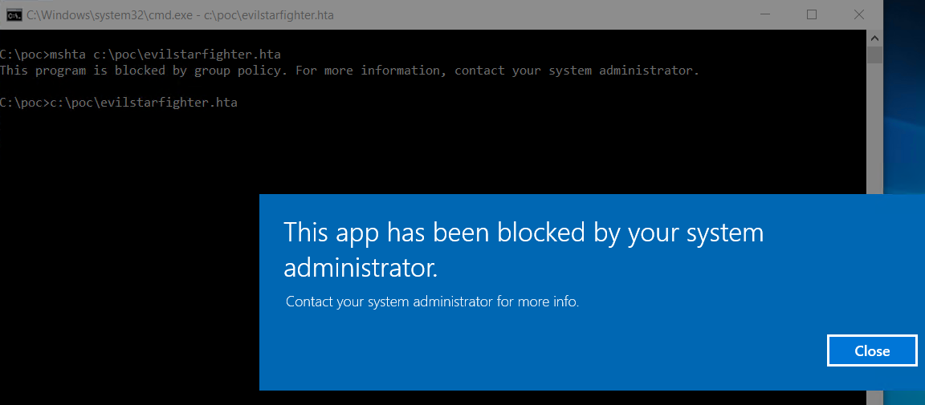
OSSEC: Application Control Policies

Slide 2
Non-standard software
Users can install and run non-standard applications
Even standard users can install some types of software
Unauthorized applications may:
Introduce malware
Increase helpdesk calls
Reduce user productivity
Undermine compliance efforts

Slide 3
Application Control
Application control is a security practice that blocks or restricts unauthorized applications from executing in ways that put data at risk.
Malicious programs compromise security. Malicious programs collect data without authorization. Malicious programs exfiltrate that data.
Identification of applications
Validation of applications
Authorization to run applications

Slide 4
Rule use / scope
Application control includes the ability to ensure applications are run only by authorized users, in addition to ensuring the user can only run authorized programs.
It can be used to reduce the likelihood of malware proliferation via watering hole by application monitoring via hash, or by not allowing unsigned applications to run at all.
It can be used as an anti-malware measure by denying all applications from running out of common vectors, such as the temp directory, IE cache, appdata, etc. This also makes application control policies one of the most effective measures again unknown malware.

Slide 5
Application control
“We’re already running with ‘standard user’ rights.”
Good uses for:
Prevent users from running “portable” (non-installed) applications
Prevent users from installing MSIs.
Restricting parts of the operating system (sol.exe)
Restricting Junior admins or “prying eyes” from “big things” (gpmc.msc)
Ensuring specific applications of “correct” version numbers are used

Slide 6

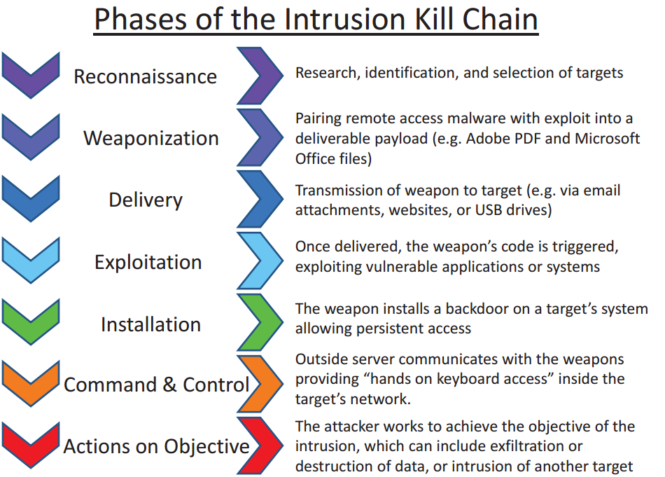

Slide 7
Application Control
Host-based firewalls prevent attacks by denying unknown connections.
Content filters prevent attacks by denying connections to known bad hosts.
Exploit mitigation prevents attacks by monitoring common OS attack points.
Application control policies prevent attacks by denying untrusted applications from running.
Anti-virus prevents attacks by stopping known malware or known malware behaviors.
First to last line of defense.

Slide 8
Two native approaches
Software Restriction Policies (SRP) – Win XP/7 not recommended
Has whitelisting and blacklisting ability
Four rule types:
Hash
Path
Windows Installer / Network Zone Rule
Certificate rules
AppLocker – 7 Ent/Ult +
We will focus on that.

Slide 9
Application Control Objectives
All good tools that rely on rules can be tuned to your needs and environment.
These needs are dictated by risk appetite.
In the case of application control policies, standardization also plays a role. The less standard an environment, the more maintenance overhead and user support investment.
The more restrictive the policy the more likely it is to interfere with user’s work.
Highly restrictive policies can also cripple operating systems.

Slide 10
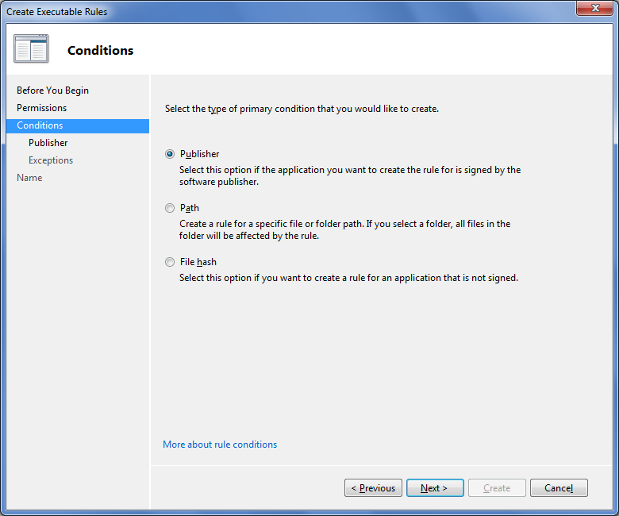
Simple Rules Structure
Allow
Limit execution to “known good” and block everything else
Deny
Deny “known bad” and allow execution of everything else
Exception
Exclude files from allow/deny rule that would normally be included

Slide 11
Trust approaches
Ways to control application execution
Trust Centric – Default Deny, allow only files on whitelist to run. (recommended)
Threat Centric – Default Allow, block files on blacklist from running.

Slide 12
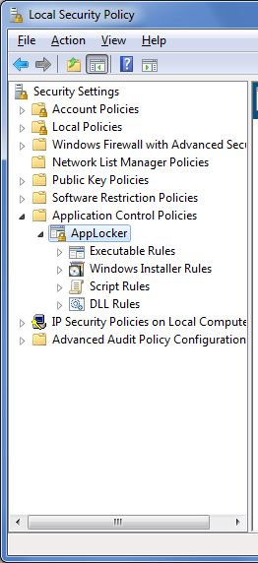
Different rule sets
Rule Types
Executable
Installer
Script
DLL
Allows construction of rules beyond executable only solutions
Provides greater flexibility and enhanced protection

Slide 13
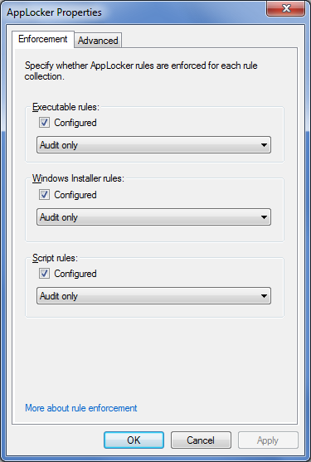
Rule Auditing
Test rules before enforcement
Events written to local audit log
Applications and Service Logs | Microsoft | Windows | AppLocker
PowerShell cmdlets
Turn audit events into rules

Slide 14
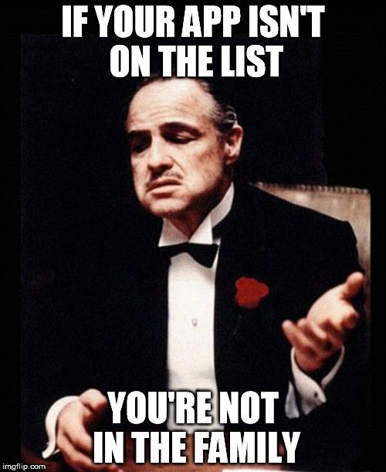
Forms of rules
Most application control platforms allow blocking based on multiple criteria. On specificity from greatest to least.
Hash
Publisher
Path
Supersedence can be used to cascade rules – usually in order of specificity (erring on the side of denial for most products.)

Slide 15
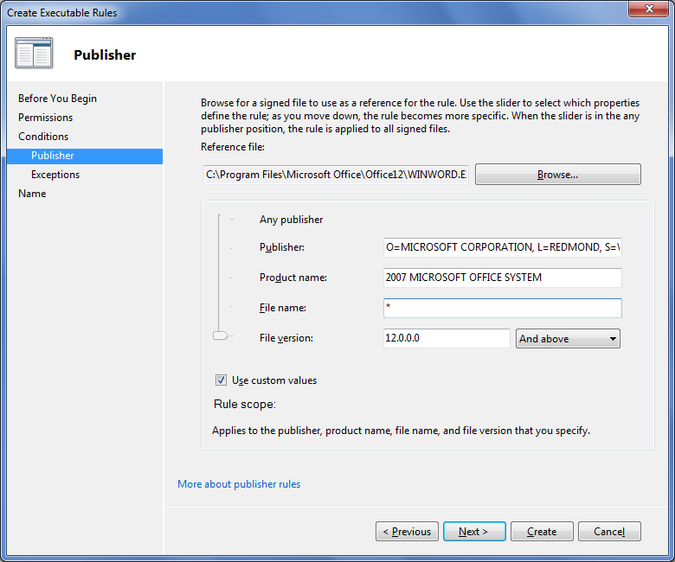
Publisher
Rules based upon application digital signatures
Can specify application attributes
Allows for rules that survive application updates

Slide 16
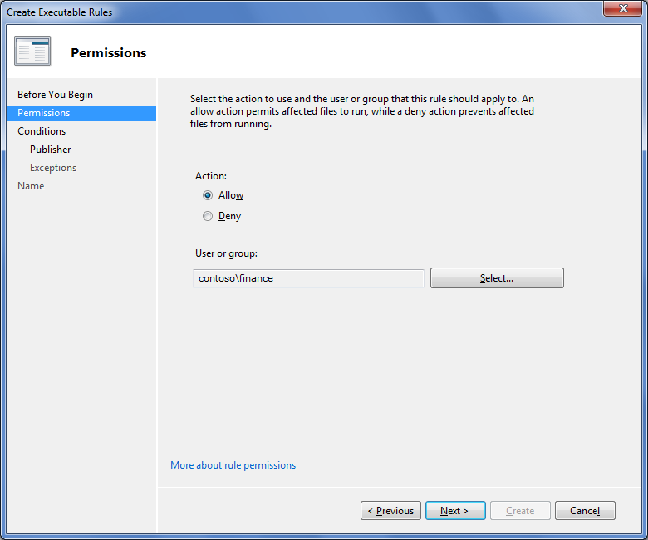
Targeting
Rules can be associated with any user or group
Provides granular control of specific applications
Supports compliance by enforcing who can run specific applications

Slide 17
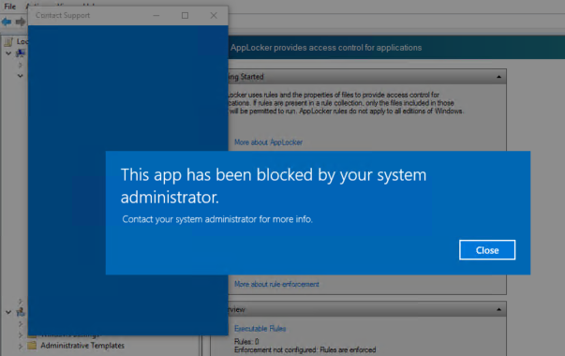

Slide 18
Implicit vs explicit
If you say something is allowed, then it is implied that anything that is not allowed is denied.
It all comes down to specificity – the allow or deny with the greater specificity wins out in the order of precedence. In a general sense, Implicit allows < Implicit denies < Explicit allows < Explicit denies. Though a more specific allow rule would take precedence.
I have an application:
Rule: | Allow C:\Program Files\*
Rule: | Allow Publisher: Hucklebuck
Rule: | Deny: C:\Prentice\Hucklebuck\*
Rule: | Allow f663bc782ae123
C:\ | Prentice\ | Hucklebuck\ | HB.exe

Slide 19
Common application control platforms
Central management for Windows systems can be done by Group Policy using Software Restriction Policies or AppLocker. Of those, AppLocker is far more robust.
For paid options, there are plenty of products that covers Windows, OS X, and Linux. However, while my experience is anecdote, I have never seen a third-party product that is as complete and seamless as a native solution.

Slide 20
Group Policy Processing
Local Policies
Site-Level Policie
Domain Policies
GP updates every 90 min by default.
Can be updated manually with gpupdate /force
Checking GP: Resultant Set of Policy (RSOP)
In Domain Policies, OU precedence takes over – the lower the OU the greater the weight in rule.

Slide 21
Common first tasks for security GP
Add endpoint admins group from AD
Rename / disable local admin account (prep for LAPS)
Disable Guest
Disable SMBv1, consider v2
Disable insecure protocols, SSL, TLS 1, consider 1.2
Set password, Kerberos, and lockout policy in Domain Default.
Even if using default settings, remember to enable the setting to enforce them. Ex. IE settings.
Set your audit policy.
Set User Rights

